Slide 1
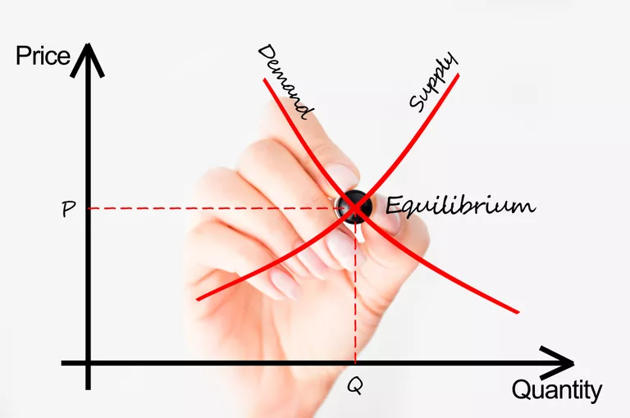
DEMAND AND SUPPLY
ECO101: INTRODUCTION TO MICROECONOMICS
FALL 2020
BRAC UNIVERSITY

Slide 2
“TEACH A PARROT THE TERMS SUPPLY AND DEMAND AND YOU’VE GOT AN ECONOMIST.”
- THOMAS CARLYLE

Slide 3
DEMAND
Demand means a willingness and capacity to pay. Unless you are willing and able to pay for it, you may want it, but you don’t demand it.
Three main characteristic's of demand
(i) Willingness and ability to pay.
(ii) Demand is always at a price.
(iii) Demand is always per unit of time.

Slide 4
DEMAND SCHEDULE AND DEMAND CURVE
A demand schedule is a table showing how much of a given product a household would be willing to buy at different prices.
The demand curve is a graph illustrating how much of a given product one would be willing to buy at different prices.
Demand curves are usually derived from demand schedules.

Slide 5
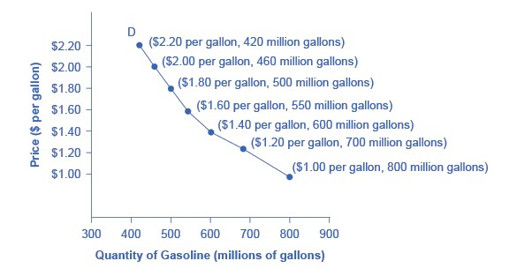
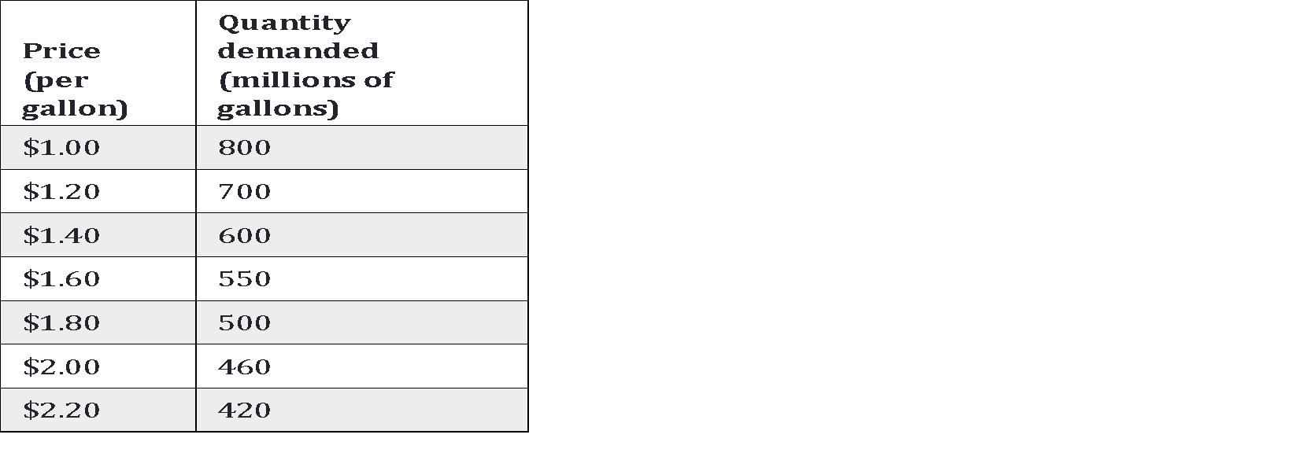
DEMAND SCHEDULE VS DEMAND CURVE
Demand schedule Demand curve

Slide 6
DEMAND VS QUANTITY DEMAND
Demand is not the same as Quantity Demanded.
Demand shows the relationship between a range of prices and the quantities demanded at those prices, as illustrated by a demand curve or a demand schedule.
Quantity demanded means only a certain point on the demand curve or one quantity on the demand schedule.
In short, demand refers to the curve, and quantity demanded refers to a specific point on the curve.

Slide 7
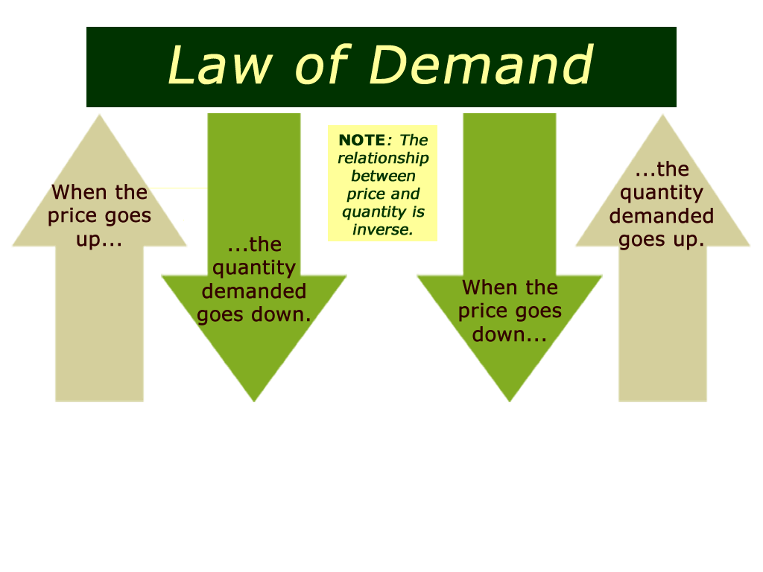
The Law of Demand
Ceteris paribus, an increase in price causes a decrease in the quantity demanded or a decrease in price causes an increase in quantity demanded.

Slide 8
WHY DOES THE DEMAND CURVE SLOPE DOWNWARD?
The law of demand states that as the price goes up, the quantity demanded goes down, other things constant.
An alternative way of saying the same thing is that price and quantity de-manded are inversely related, so the demand curve slopes downward to the right.

Slide 9
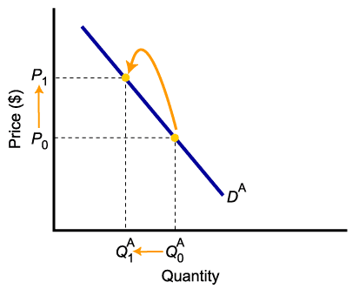
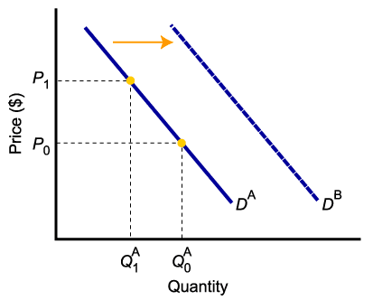
SHIFT OF DEMAND VERSUS MOVEMENT ALONG A DEMAND CURVE
A change in demand is not the same as a change in quantity demanded.
In the left diagram, a higher price causes lower quantity demanded.
Changes in determinants of demand, other than price, cause a change in demand, or a shift of the entire demand curve, from D_{A} to D_{B}.

Slide 10
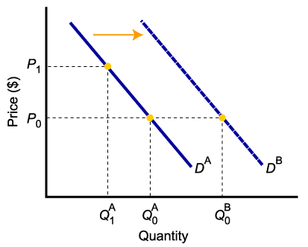
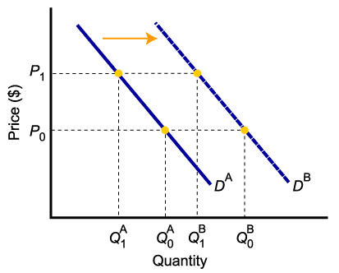
A CHANGE IN DEMAND VERSUS A CHANGE IN QUANTITY DEMANDED
When demand shifts to the right, demand increases. This causes quantity demanded to be greater than it was prior to the shift, for each and every price level.

